Slide 1
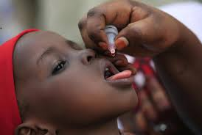
Equipment used in a pediatrics unit
Equipment used in the pediatrics unit
Equipment also used in the neonatal ICU
18.3.1 Identify equipment used in a pediatrics unit
UNIT C18.3 Maintaining Pediatric Equipment
Module 279 19 C Medical Instrumentation II
©
dr. Chris R. Mol, BME, NORTEC, 2015

Slide 2
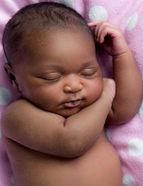
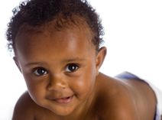
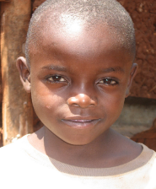
Classification of children in Pediatrics
Neonate
first 28 days of life
Infancy
birth to 1 year
School-ager
6 to 10 years
Toddler
1 to 3 years
Pre-schooler
3 to 6 years
Pre-pubertal
10 to 13 years
Adolescent
13 to 18+ (21 in the US) years
©
Paediatric equipment
dr. Chris R. Mol, BME, NORTEC, 2015

Slide 3
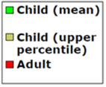
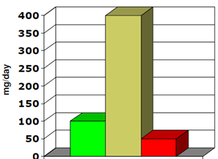
Children are not ‘little adults’
Children have a different body size & maturation
The smaller body of an infant or neonate is substantially different physiologically from that of an adult.
Congenital defects, genetic variance, and developmental issues are of greater concern to pediatricians than they are to adult physicians.
The clinician must take into account the immature physiology of the infant or child when considering symptoms, prescribing medications, and diagnosing illnesses.
Children are more vulnerable to environmental hazards
Children (adolescents!) may take unreasonable risks due to cognitive immaturity and "risk-taking" behaviours
obstructed breathing (swallowed foreign object)
malnutrition
ingested poisons
birth related problems
drowning
snake bites & scorpion stings
HIV/Aids
soil consumption
©
Paediatric equipment
dr. Chris R. Mol, BME, NORTEC, 2015

Slide 4
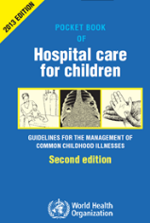
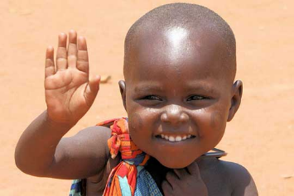
Children are not ‘little adults’
It is more difficult to communicate with children
Pre-reading children cannot read warning signs & labels
Children cannot always tell their complaints
Children cannot (always) make decisions for themselves.
The issues of guardianship, privacy, legal responsibility and informed consent must always be considered.
The concept of legal consent when considering treatment options, especially in the face of conditions with poor prognosis or complicated and painful procedures, means the pediatrician must take into account the desires of many people, not just the patient.
©
Paediatric equipment
dr. Chris R. Mol, BME, NORTEC, 2015

Slide 5
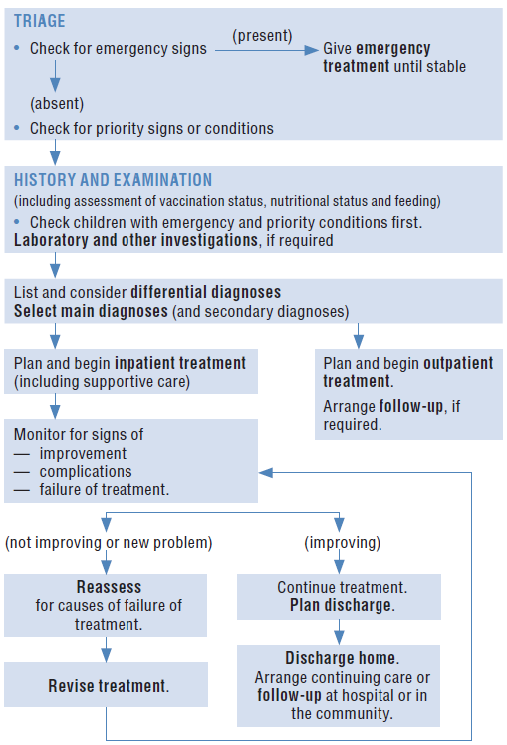
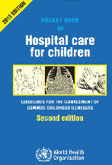
Stages in the management of a sick child admitted to the hospital
Triage is the process of rapidly screening sick children soon after their arrival in hospital, in order to identify:
those with emergency signs, who require immediate emergency treatment;
those with priority signs, who should be given priority in the queue so that hey can be assessed and treated without delay;
non-urgent cases, who have neither emergency nor priority signs.
Pediatric examination often includes: lab analysis of blood, microscopy analysis of urine & faeces, pulse oximetry and chest x-ray
Differential diagnostic is a process of elimination of alternative possible diseases, by using evidence such as symptoms, patient history, and medical knowledge.
©
Paediatric equipment
dr. Chris R. Mol, BME, NORTEC, 2015

Slide 6
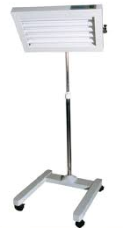
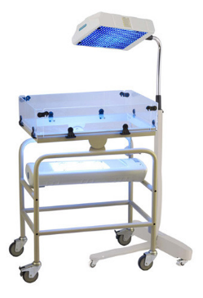
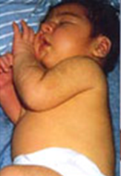
Photo Therapy unit
Free standing
Phototherapy unit
A phototherapy device is used to treat hyper-bilirubinemia, a disease which often occurs in babies and is characterized by high bilirubin concentrations in the blood. Jaundiced new-borns have yellow discoloration of the white part of the eye, and yellowing of the face, extending down onto the chest.
Devices using overhead lamps can be freestanding on casters, ceiling or wall mounted, or attached to infant radiant warmers or infant incubators; some units have height and hood angle adjustments.
Bassinet-style units, in which the infant is placed in a plastic bassinet containing a bank of lights in an overhead case, are also available.
Baby with high Bilirubinemia
Bassinet-style
Phototherapy unit
©
Paediatric equipment
dr. Chris R. Mol, BME, NORTEC, 2015

Slide 7
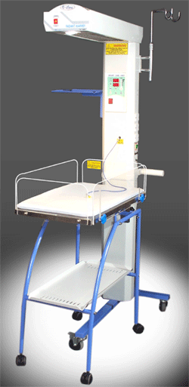
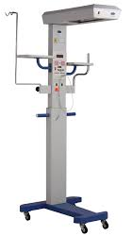
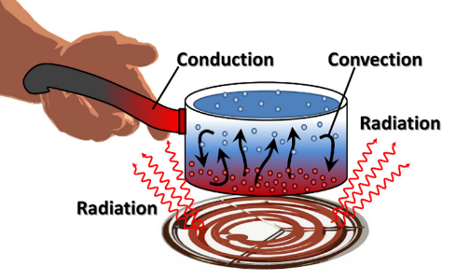
Radiant Warmer
Radiant warmers (and incubators) are used to maintain the body temperature of new-born infants. This is done to minimize the energy that is required for metabolic heat production. Hypothermia at birth is one of the most important risk factors for new-born mortality.
©
Paediatric equipment
dr. Chris R. Mol, BME, NORTEC, 2015

Slide 8
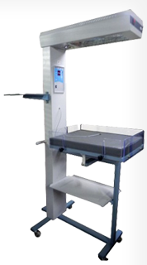
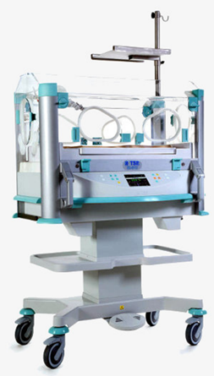
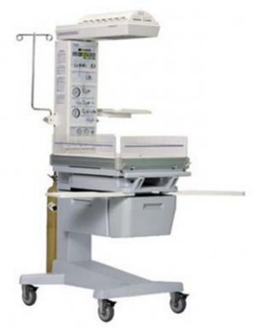
Radiant Warmer, Incubator, Resuscitaire
Radiant warmer:
heat only for new-borns
Incubator:
long term environment
Resuscitaire:
intensive care at birth
©
Paediatric equipment
dr. Chris R. Mol, BME, NORTEC, 2015

Slide 9
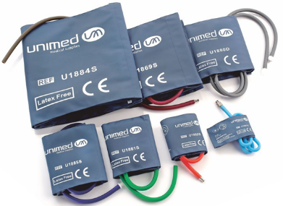
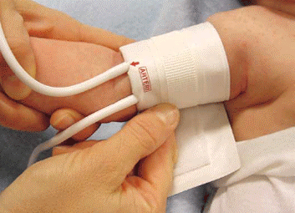
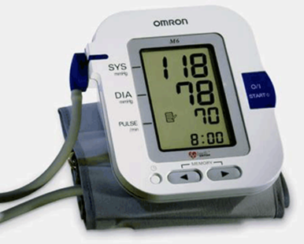
Infant Blood pressure machine
The ‘pediatric use’ of a blood pressure machine is not very different from the ‘adult use’.
©
Paediatric equipment
dr. Chris R. Mol, BME, NORTEC, 2015

Slide 10
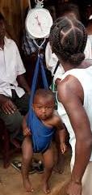
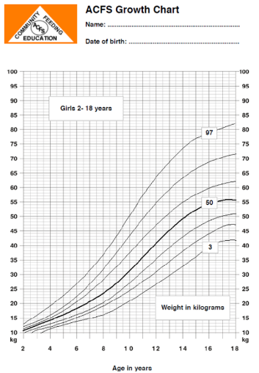
Infant weighing scale
A baby scale is a specially-designed scale to monitor the progress of a baby’s physical development.
If a baby is born prematurely, it is often important to closely monitor their weight gain with a baby scale, more often than for on-time babies.
©
Paediatric equipment
dr. Chris R. Mol, BME, NORTEC, 2015

Slide 11
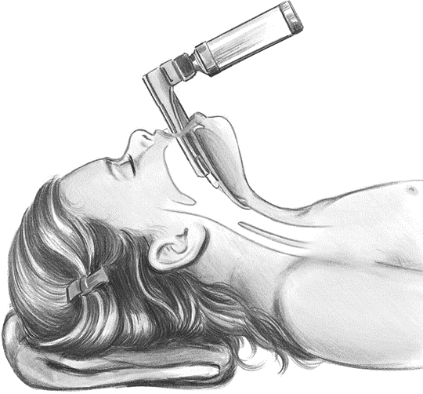
Laryngoscope
Laryngoscopy (larynx + scopy) is a medical procedure that is used to obtain a view of the vocal cords and the glottis.
Laryngoscopy may be performed:
to facilitate tracheal intubation during general anesthesia or cardio-pulmonary resuscitation
to execute procedures on the larynx or other parts of the upper trachea-bronchial tree, for example biopsies.
©
Paediatric equipment
dr. Chris R. Mol, BME, NORTEC, 2015

Slide 12
END
The creation of this presentation was supported by a grant from THET:
see https://www.thet.org/

